Slide 1
Vision System Redesign and CAMBADA Basestation
Bernardo Cunha, Ricardo Dias,
Francisco Pinto, Nuno Lau
RoboCup Scientific Challenge 2019 – Sydney, Australia

Slide 2
Exploratory Vision System Redesign
Basestation Tool

Slide 3
Exploratory Vision System Redesign
Basestation Tool

Slide 4
Vision System Redesign Motivation
Mechanical structural issues:
Mirror support stability degrades over time
Increase of the field size (22m x 14m)
Reduces accuracy in self localization
Reduces accuracy in far object detection (ball and robots)

Slide 5
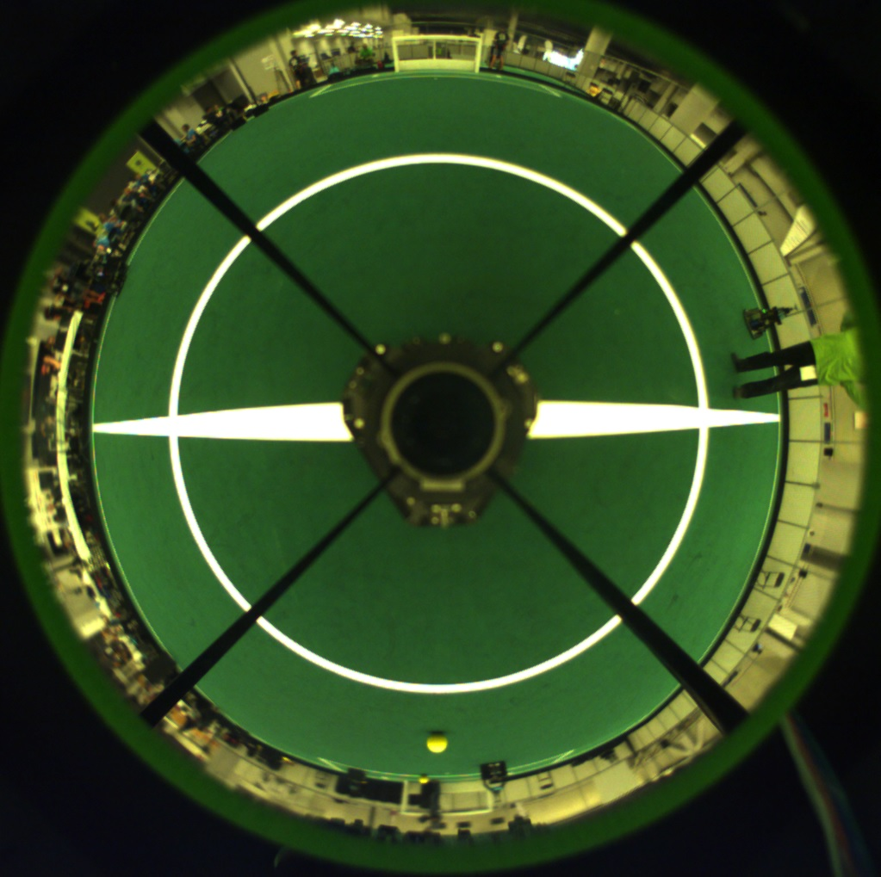
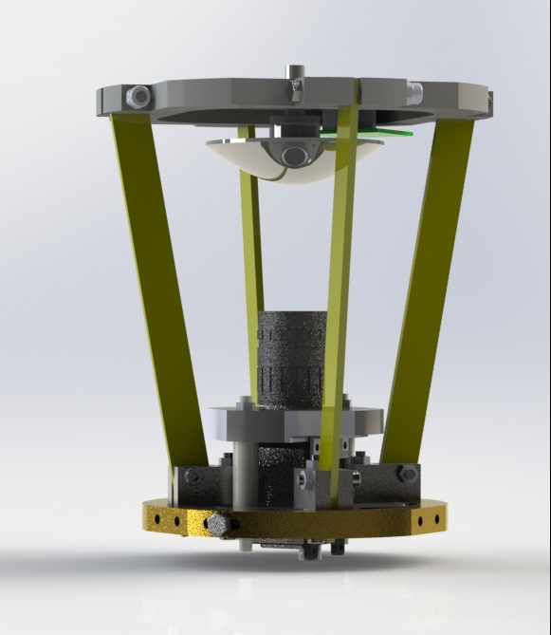
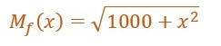
Vision System Redesign Motivation
Current mechanical catadioptric vision system with titanium vertical bars

Slide 6
Vision System Redesign Motivation
System is 5 years old.
Mirror is 12 years old
Flexibility of the supporting bars seams to decrease over time due to stress

Slide 7
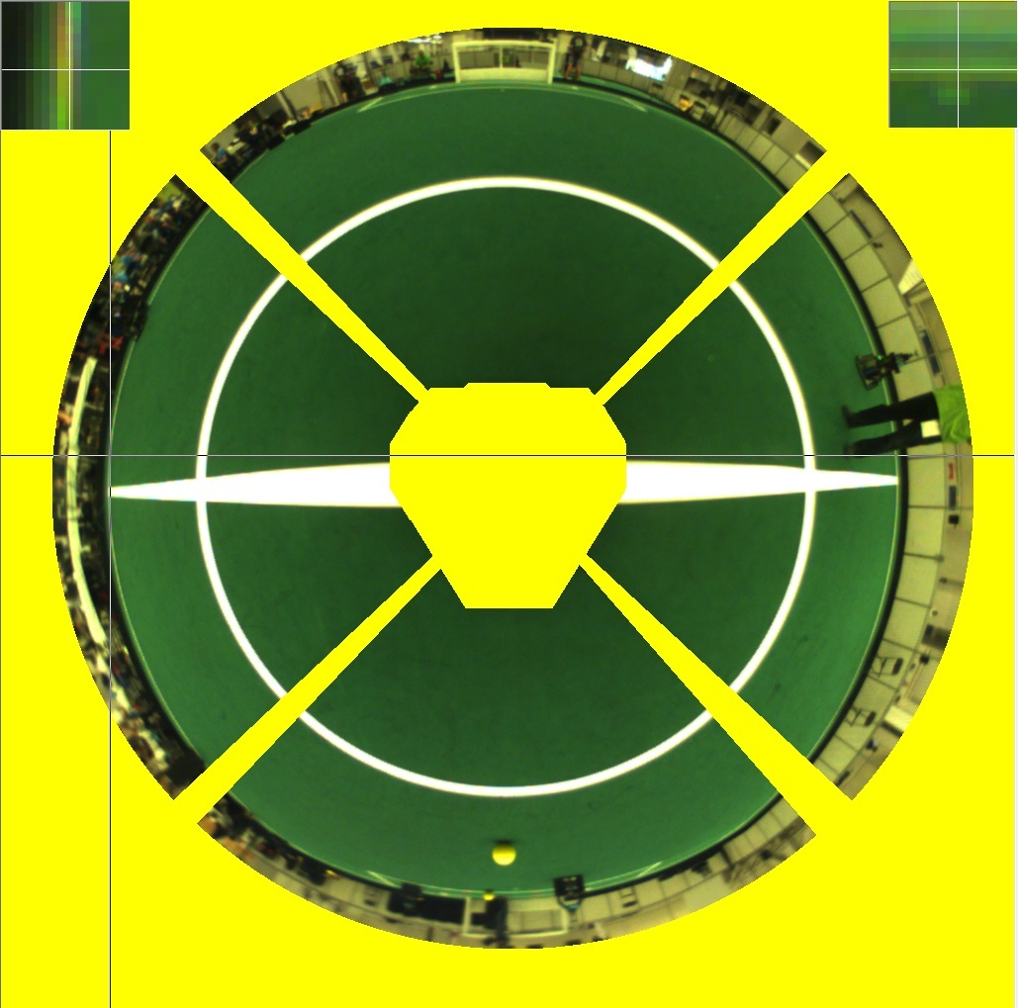
Vision System Redesign Motivation
Calibration procedure starts with a single frame, obtained with at the center of the field.
Based on this frame, we determine a mask (in yellow) that excludes pixels not relevant for further processing
Left top corner – 8x zoom of side white line
Right top corner –8x zoom of penalty mark

Slide 8
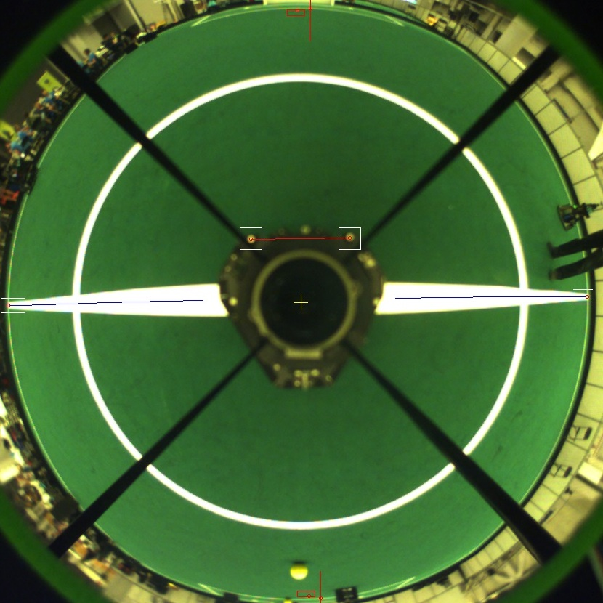
Vision System Redesign Motivation
We then get sub-pixel resolution location of left and right T tops, as well as both penalty markers
Based on these points and the knowledge of their location in real world, we move into obtaining the extrinsic parameters of the camera

Slide 9
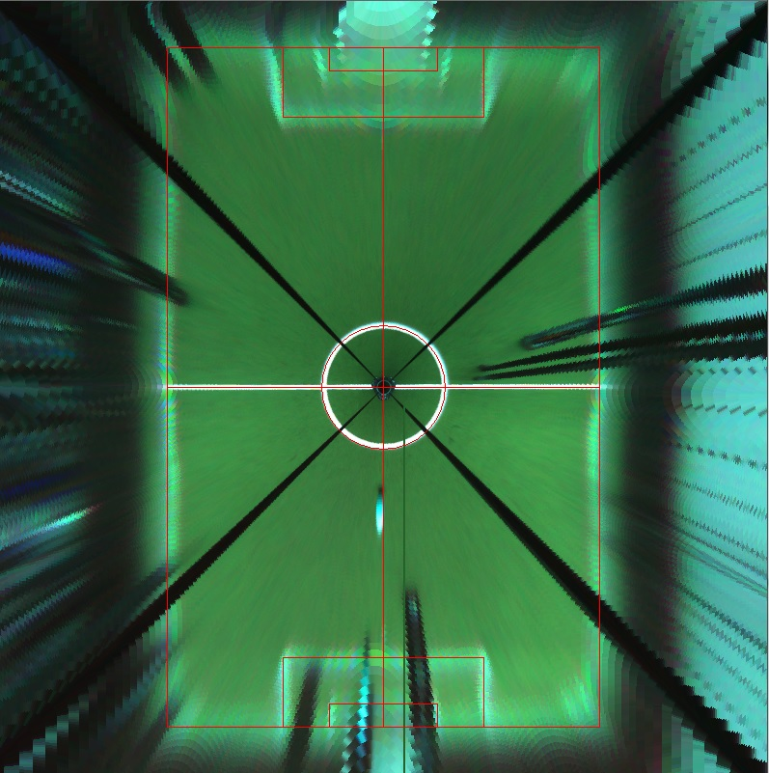
Vision System Redesign Motivation
A final distance map on the ground plane is then generated based on the obtained parameters
On the left an eagle-eye view of the resulting map (22mx14m field)

Slide 10

Vision System Redesign Motivation
BUT: the effective space resolution is actually the one shown on the image
Current mirror provides a very high resolution close to the robot but a very poor one when we move away.

Slide 11
Vision System Redesign Motivation
Furthermore, during a stressful competition, and after being hit by the ball several times, the mirror supporting system will slightly get misaligned over time.
Extrinsic parameters may, therefore, be no longer valid after 3 or 4 games implying new recalibration

Slide 12
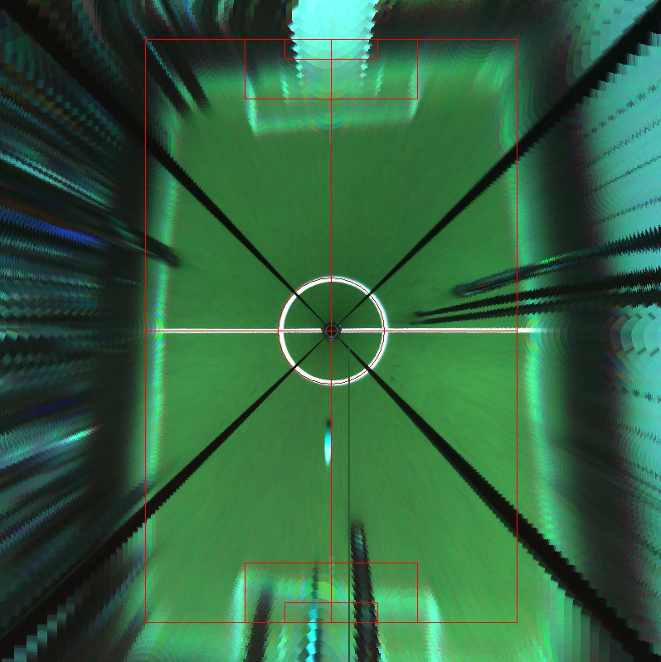
Vision System Redesign Motivation
De image on the left is the result of a 0.5 degree error in one of the mirror back plane axis
This will result in errors at distances > 2m, which may result in significant localization issues

Slide 13
Vision System Redesign Motivation
In summary:
We needed a more stable mechanical solution for the vision system
We redesigned our mirror so that distribution of spatial resolution may enhanced:
by reducing significantly the resolution close to the robot
by reducing the size of the robot body on the image
by increasing resolution at higher distances
by trying to keep resolution degradation more linear
while still being able to see above the floor at least 1m

Slide 14
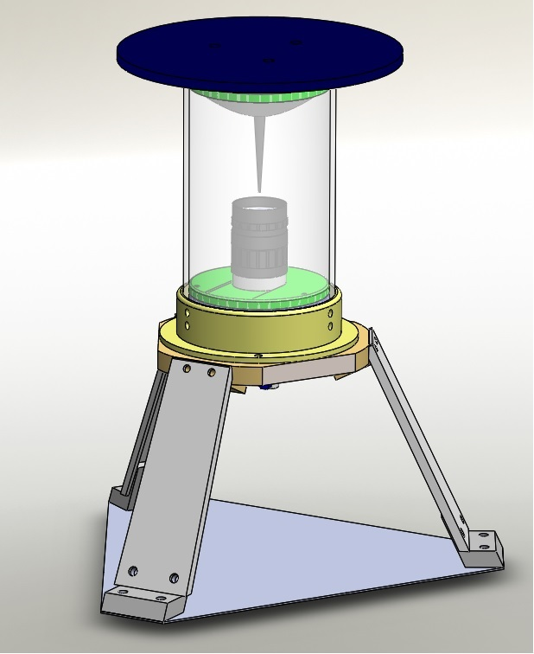
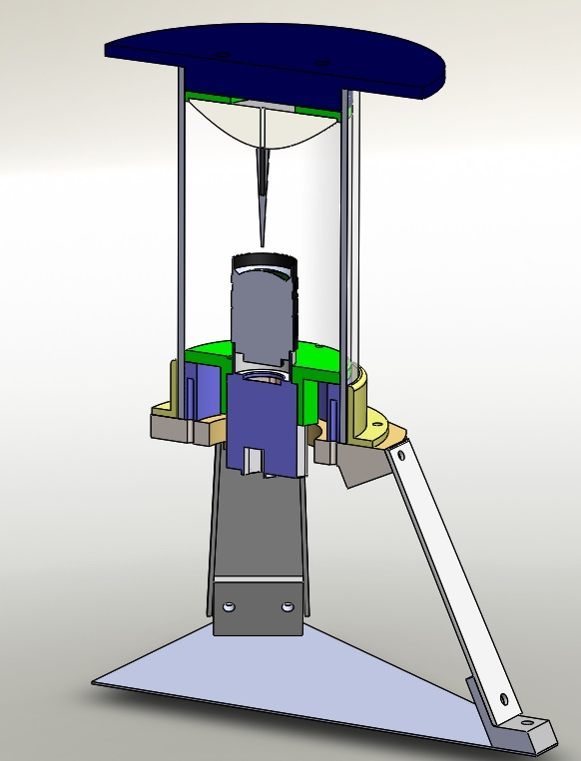
Vision System Redesign Mechanical solution
Nothing fundamentally new here

Slide 15
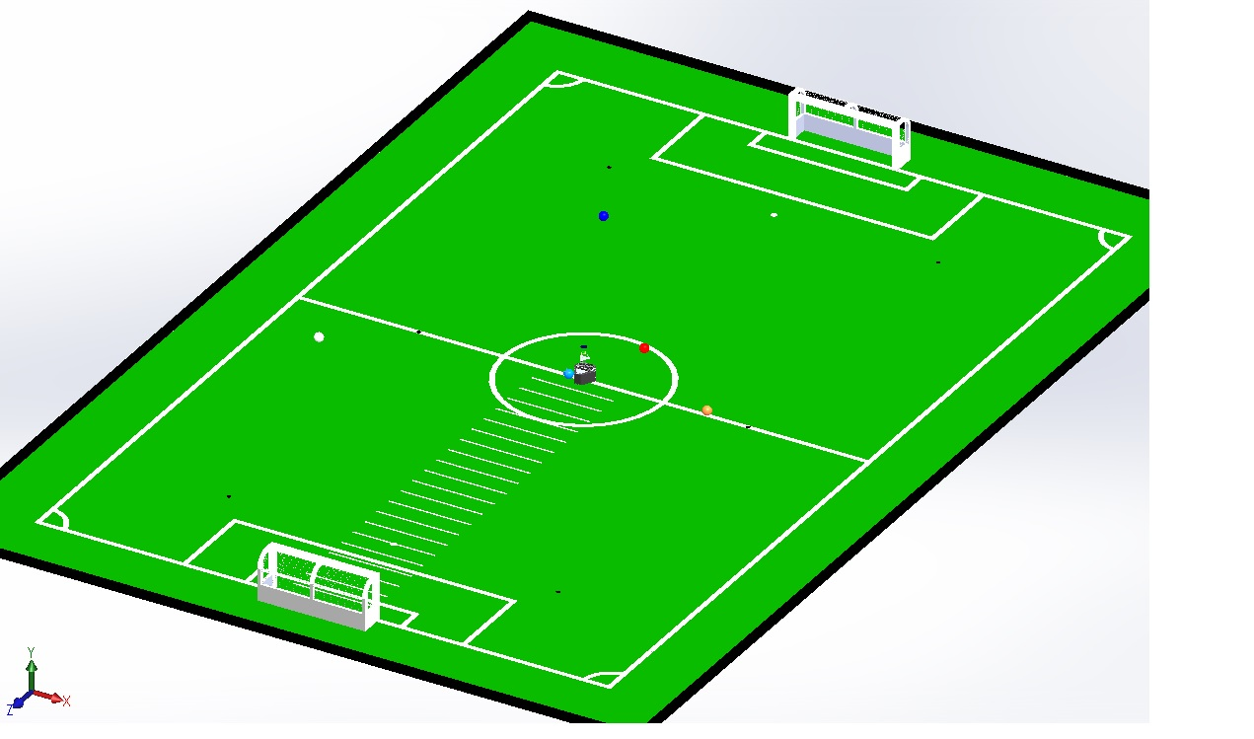
Vision System Redesign Mirror redesign
Simulated full size field design with a robot at the center

Slide 16
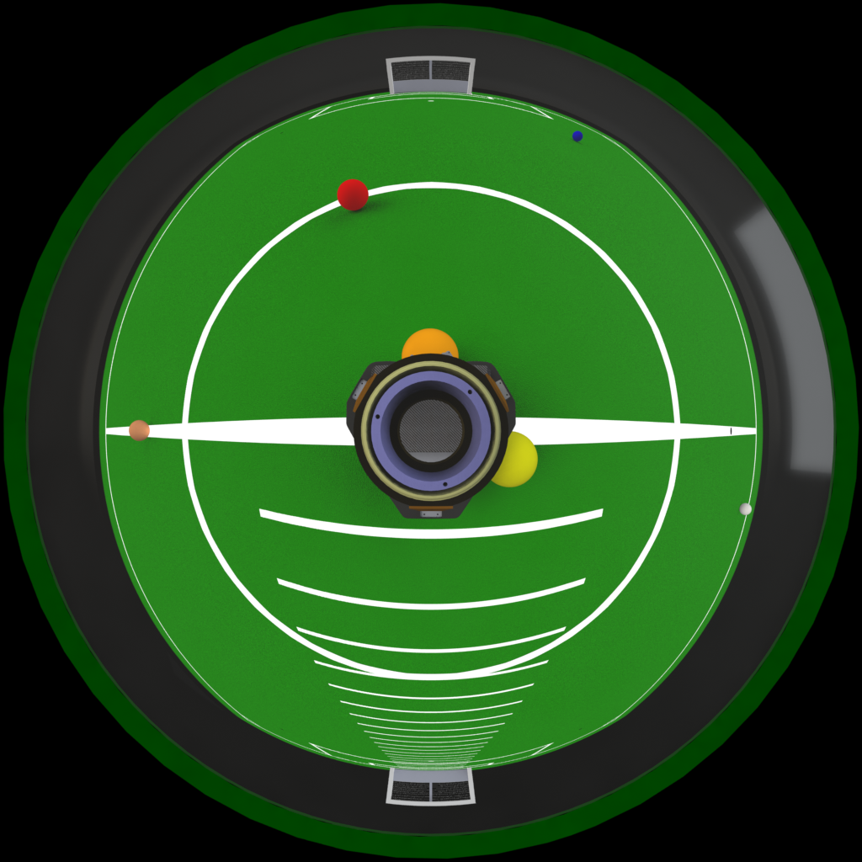
Vision System Redesign Mirror redesign
Just to recall:
Simulated view of current mirror

Slide 17
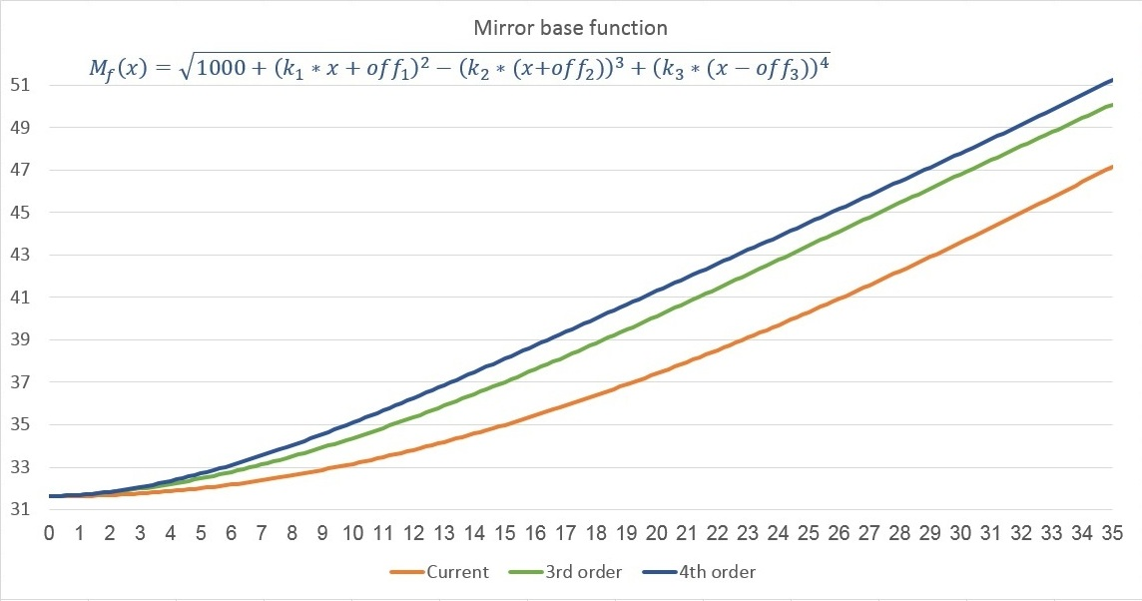
Vision System Redesign Mirror redesign

Slide 18
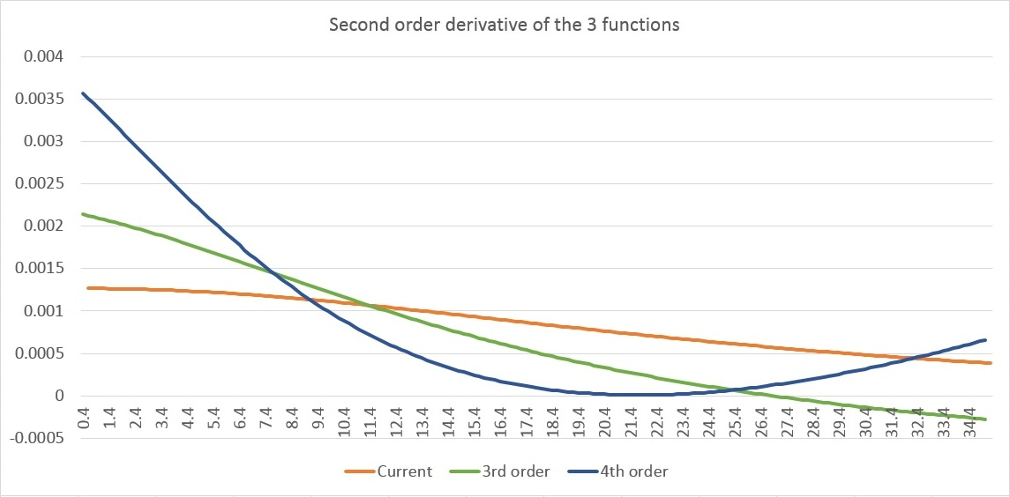
Vision System Redesign Mirror redesign

Slide 19
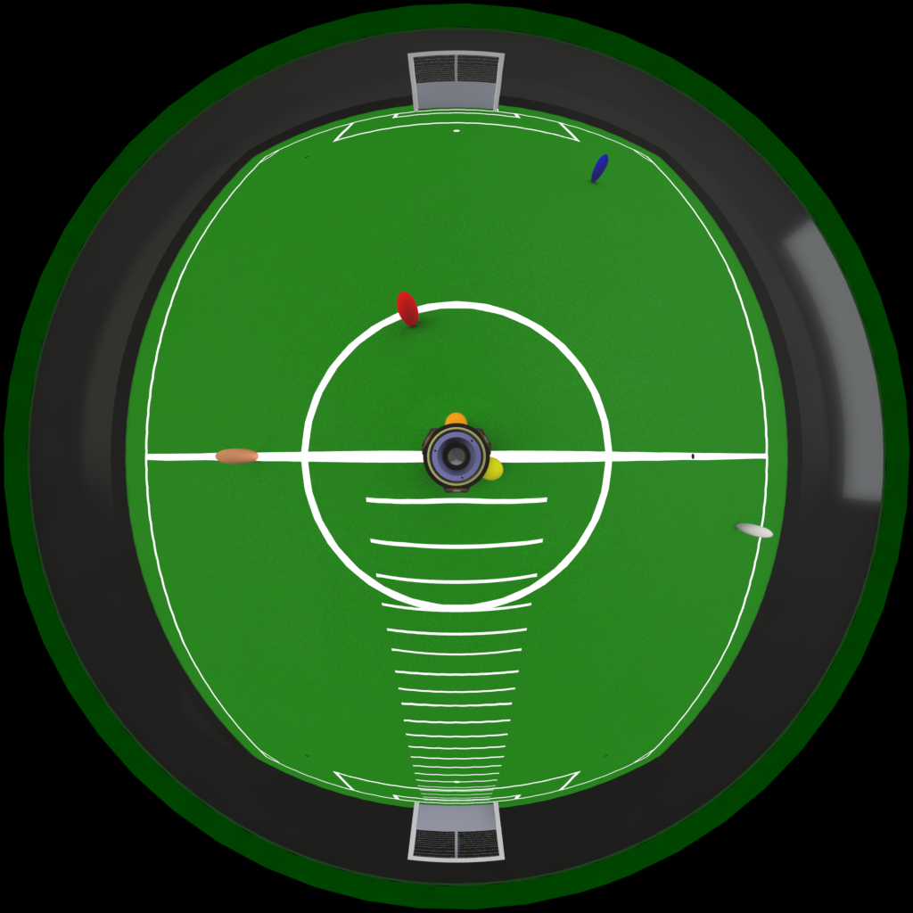
Vision System Redesign Mirror redesign

Slide 20
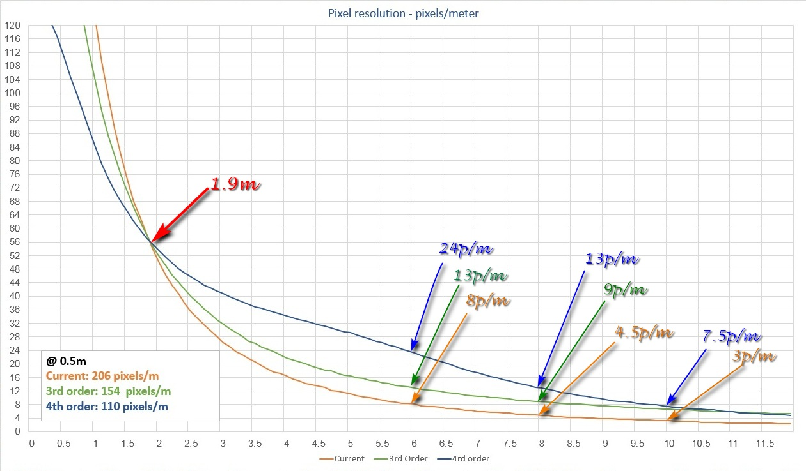
Vision System Redesign Mirror redesign

Slide 21
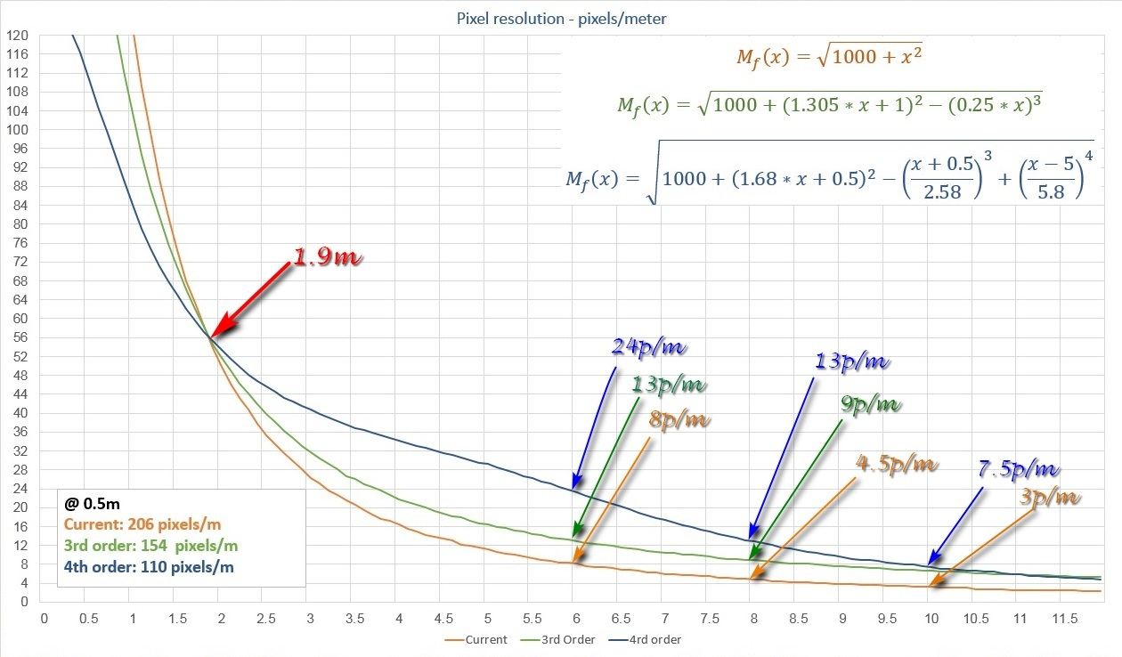
Vision System Redesign Mirror redesign

Slide 22
Vision System Redesign Challenges
Increase in radial spatial resolution at greater distances also imply that angle resolution is decreased
Those two effects combined will turn balls into ellipses and obstacles will turn out thinner
Algorithms will have to be re-tuned to handle this effect

Slide 23
Exploratory Vision System Redesign
Basestation Tool

Slide 24
Basestation Features
Show Robots State in Real-Time
World State Visualization (3D)
Debugging
Connection to the real RefBox
Performing RefBox Emulation
Performing automatic Logging
Allowing Instant-Replay
Sync’ed Video Player
Set Play editor already integrated

Slide 25
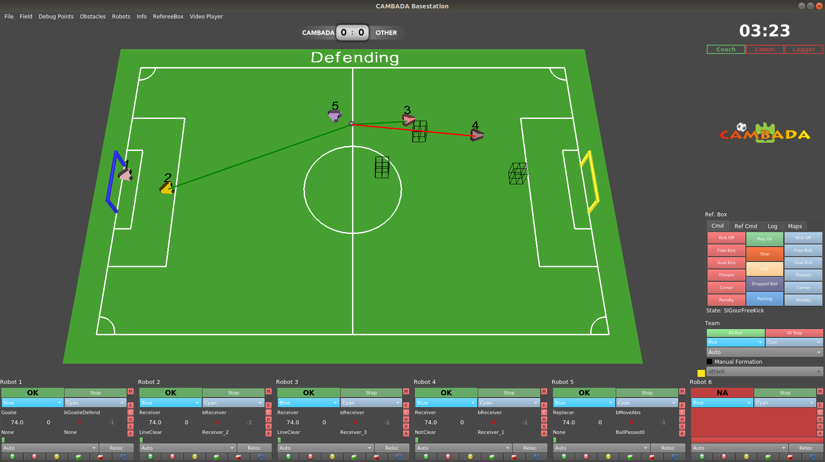
Basestation Overview

Slide 26
Robot Widget

Slide 27
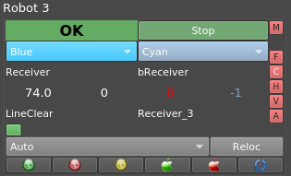
Robot Widget

Slide 28
Robot Widget
Connection Status
Run / Stop Button
OK (robot running)
Stand-by (robot connected but not running)
NA (robot not connected – unknow status)

Slide 29
Robot Widget
Our Goal
Our Color
This is still legacy terminology
We still use Blue / Yellow to distinguish between goals
Define team color for ref-box commands
Doing this per-robot allows us to perform tests against ourselves

Slide 30
Robot Widget
Current Role
Current Behaviour
Decision/Strategy feedback
Which Role the robot is in (Goalkeeper, Defender, Attacker, …)
Which behavior the robot is assuming inside that role

Slide 31
Robot Widget
4 General Purpose Numeric Fields
We can select which info to show
Usually: LiPo battery pack voltage level, laptop battery level, motor temperature, …

Slide 32
Robot Widget
Coordination Flag 2
Coordination Flag 1
Coordination flags are used to coordinate actions between robots (for inter-agent interactions such as pass/reception)

Slide 33
Robot Widget
RtDB Info Lifetime
Progress Bar from 0 to 2 seconds
Displays elapsed seconds in text if higher than 2 seconds

Slide 34
Robot Widget
Force “Relocalization”
Force Role
Used mainly to test roles
Bypass dynamic role selection
If we do tests and the robot is “lost”, we can click this button to restart the localization algorithm

Slide 35
Robot Widget
RE-START
Agent Process
START
Process Watchdog
STOP All Processes
STOP
Process Watchdog
START All Processes
Reboot Laptop
Access to fast common actions we perform on the robots

Slide 36
Robot Widget
State of All
Processes
Red = Not Running / Green = Running
Click to toggle state

Slide 37
Side Panel

Slide 38
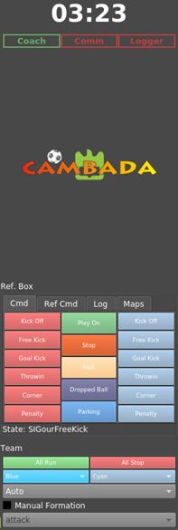
Side Panel
4 Tabbed Views
Ref-Box Signals Emulator
Log of Received Signals from Ref-Box
Load CAMBADA Logfile
Coach Info Selection
Tabbed View
Last Command Received

Slide 39
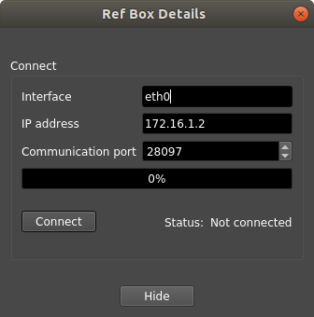
Connection to the RefBox
RefBox state follows an LTP criteria
When connected to the RefBox, we can override commands if needed

Slide 40
Automatic Logging
As soon as the basestation is loaded, it starts logging automatically
Circular Buffer of temp files
2 Main Advantages
Backup
Logging
Instant
Replay

Slide 41
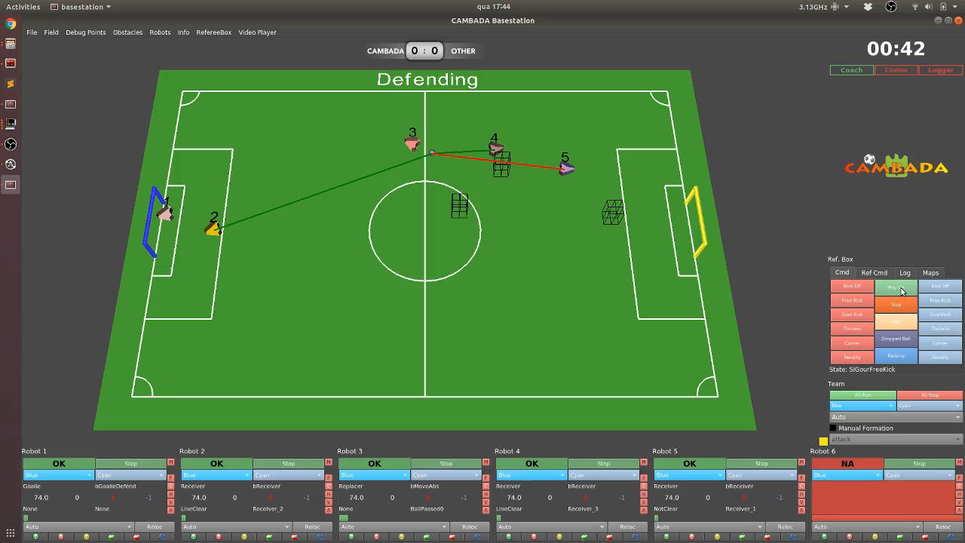
Instant Replay

Slide 42

Interactive Main 3D View

Slide 43
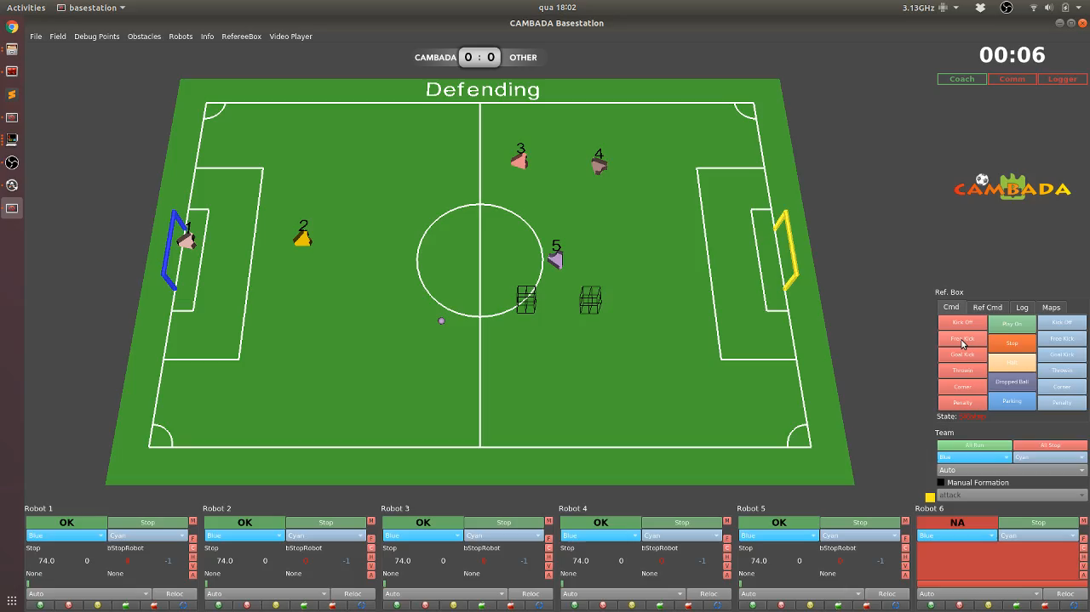
Obstacles and Debug Points

Slide 44
Per-Robot Perception
Own Pose (pos + ori)
Ball (pos + vel)
Obstacles Detected (pos + vel)
Debug Points
Navigation Plan Target / Waypoint
Pass lines (green = free / red = blocked)

Slide 45
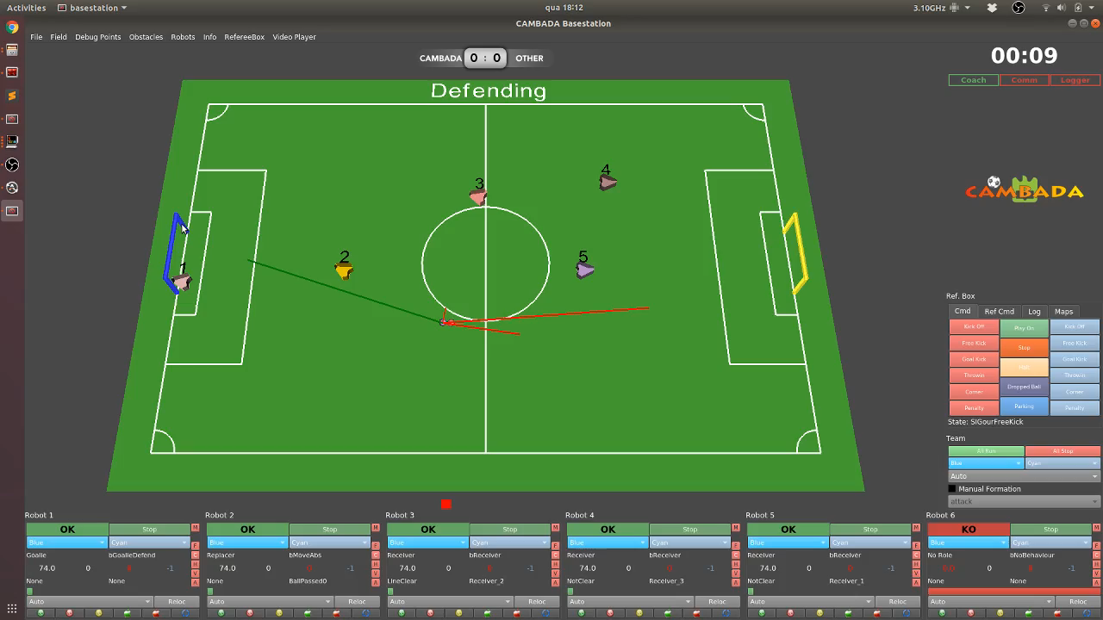
Coach Information Unified Obstacles Perception

Slide 46
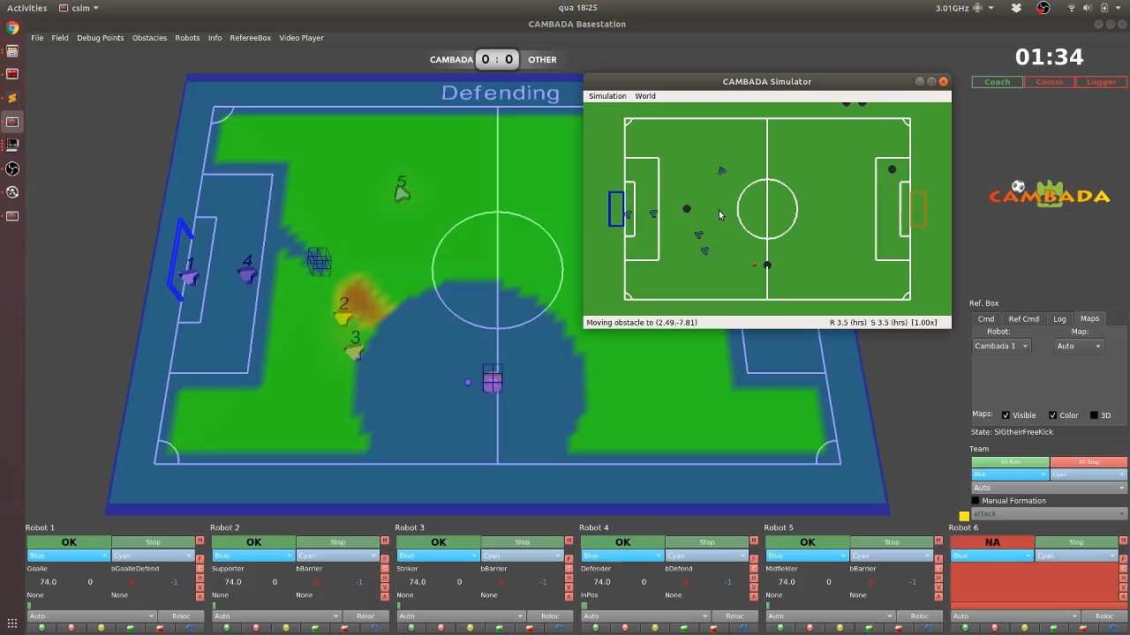
Coach Information Heat Maps

Slide 47
Sync’ed Video Player
When analyzing log files offline, it is sometimes useful to have a video recording side-by-side
We integrated a syncing system between the log and the footage.
Initially the system is setup manually, and then we can to analyze particular situations of the game while compare the log with reality

Slide 48
Sync’ed Video Player
So, we have implemented a video player inside the Basestation
How to use it:
Scroll to any frame of the log (using the replay slider)
Scroll to the frame on the video player that corresponds to the frame selected on the log
Click “Sync” button
Now you can scroll through the log and the video player will follow in sync

Slide 49
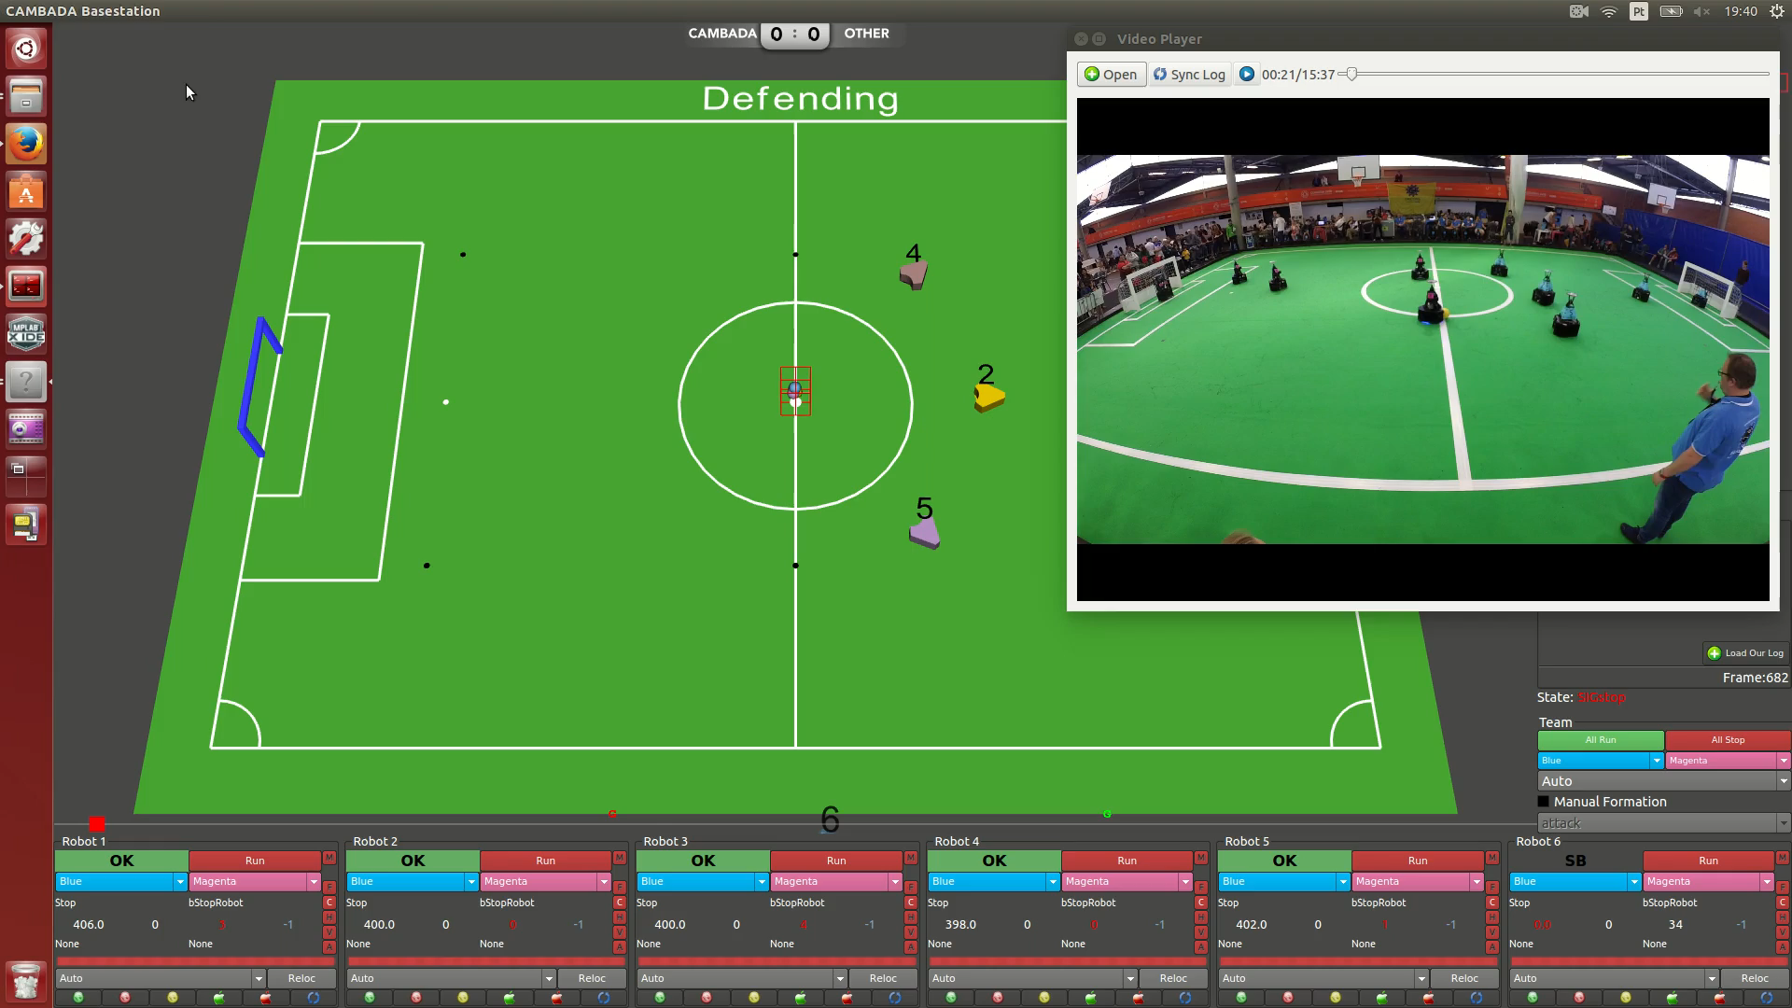
Sync’ed Video Player

Slide 50
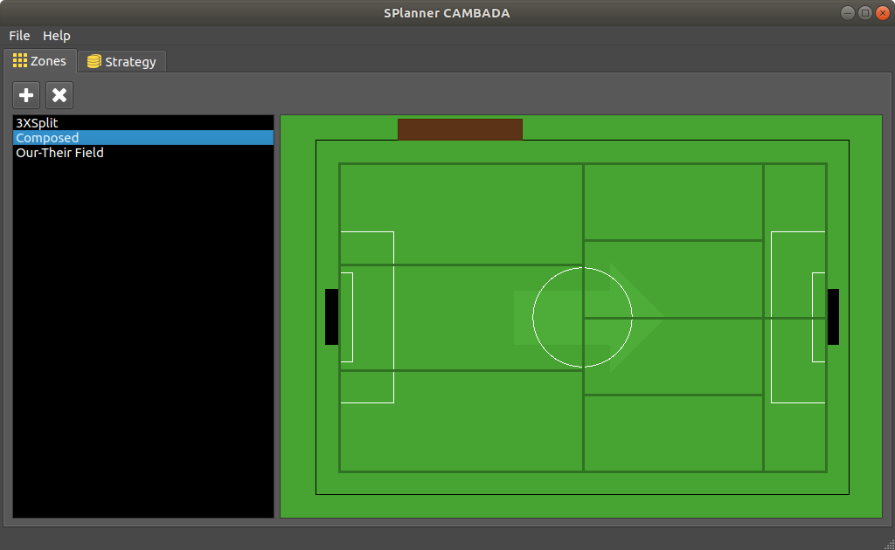
Set Play editor
Example of definitions of field areas for a set-play

Slide 51
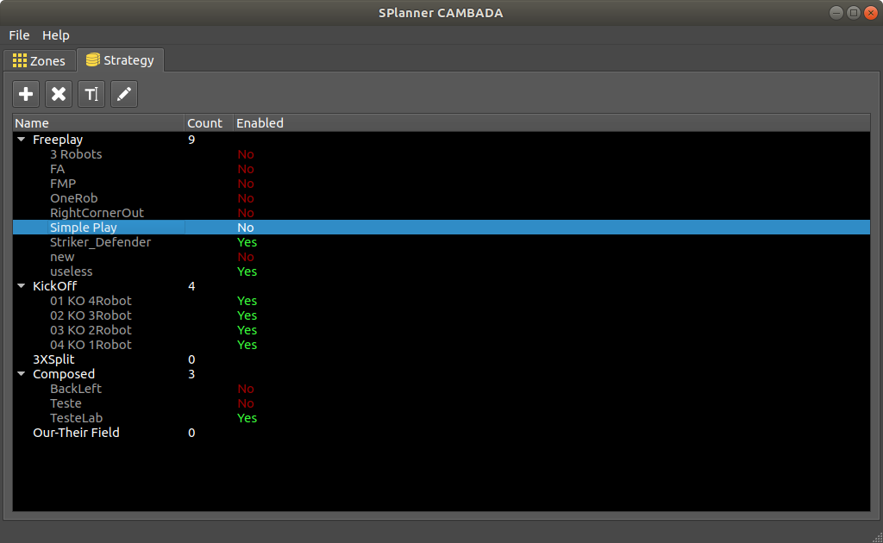
Set Play editor
Strategy level: table list of all set-plays

Slide 52
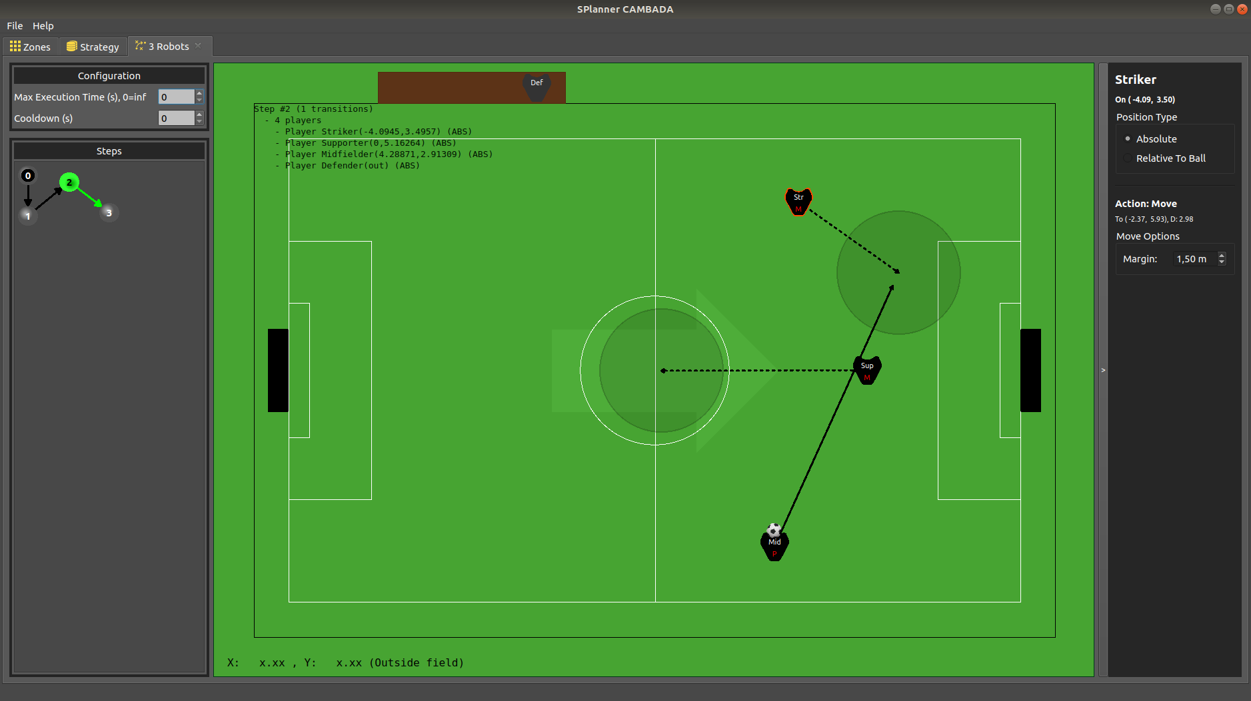
Set Play editor
Edition example of a set-play

Slide 53
Some ideas in progress…
Robot Manual Remote Control
For repositioning during tests and to control tuning tests
Robot Taxi/Uber/Cabify/Cambadafy
Drag and drop a robot in the 3D to move it to the desired position
Robot Maintenance
Run a diagnostic and get results

Slide 54
Some ideas in progress…
Fully automation of Robot Calibration
Vision, grabbers, etc…
Integrated RtDB Logging
Our log is currently a dump from RtDB into an XML file
We will change it to RtDB tagged data directly
Integrate MSL Standard JSON WorldState Log
Compare the other team data with our perception in offline

Slide 55



Thanks for your attention!
/cambadamsl /cambadamsl robotica.ua.pt

